Slide 2




Homogenization of the system
 In parallel design process, several stimuli with the same purpose or meaning are defined by several designers. These stimuli should be consolidated to obtain as few stimuli as possible. It is called homogenization.
 Homogenize - to change (something) so that its parts are the same or similar.
Refine your model through homogenization

Slide 3

Why is homogenization required
If different teams are working on different scenarios, a class may be called by different names.
These name conflicts must be resolved.
Homogenization is an ongoing process.

Slide 4

Elements of Homogenization
COMBINING CLASSES
SPLITTING CLASSES
ELIMINATING CLASSES
SCENARIO WALK THROUGH
EVENT TRACING
DOCUMENTATION REVIEW

Slide 5

Homogenization
COMBINING CLASSES
examine each class with its definition.
Examine attributes and functions of the classes.
Look for the use of synonyms.
If more than one class have same behavior and same information merge into one class
Once you determine that the 2 classes are doing the same thing, choose the name that is closest to the language used by the customer.
Pay careful attention to the control classes

Slide 6

Homogenization
SPLITTING CLASSES
Classes should be examined if they are following the golden rule of OO, that is A class should do one thing and it should do really well.
Example :
A StudentInformation class contains:
Info about student Actor
And info about the courses that student has successfully completed.
Resolve into 2 classes: StudentInfo and Transcript.

Slide 7
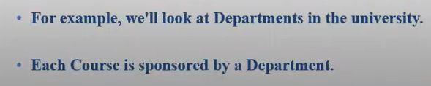
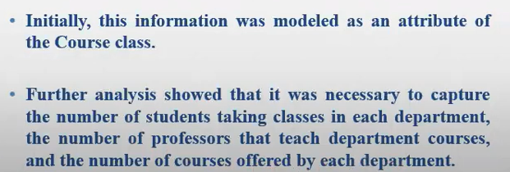
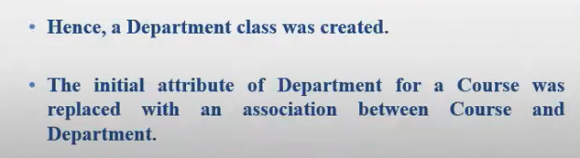
Example on splitting classes

Slide 8
Splitting classes
Example : structural programing(you are writing all your code in main method )

Slide 9

Homogenization
ELIMINATING CLASSES
When?
A class does not have any structure or behavior
The class does not participate in any use cases
Guideline: Look for the control classes in particular. Lack of the sequencing responsibility may lead to the deletion of the class.
Example:
A control class is only a pass through or a forwarder. I.e., it received information from boundary class and only passes it to the entity class without the need of sequencing logic.

Slide 10

Homogenization
CONSISTENCY CHECKING
Why ?
Because static view of the system and dynamic view of the system and interaction view of the system are under development in parallel.
Consistency checking is necessary to check if all the 3 views of the system has the same assumptions / decisions and terminology used.
Consistency Checking is done by forming a small team.
Team members 5-6.
Analyst, Designer, Customer / Customer Rep., Domain experts.

Slide 11

Homogenization
SCENARIO WALK THROUGH
A simple method of consistency checking is walk through of high risk scenario as represented by sequence / collaboration diagrams.
Specially check the reflexive relationships because they are likely to miss during analysis.
Reflexive relationships are needed when multiple objects of the same class interacts during a single scenario.
Finally verify that each object in sequence / collaboration diagram belongs to a class on the class diagram.

Slide 12

Homogenization
EVENT TRACKING
For every message on the sequence / collaboration diagrams:
Verify that an operation is responsible to send the message in the sending class
Verify that an operation is responsible to receive the
message in the receiving class and handles it properly.
Verify that there exists some kind of association between sending and receiving classes on the class diagram.
Verify each message in the state transition diagram.

Slide 13

Homogenization
DOCUMENTATION REVIEW
Each class should be documented.
Verify that each method and attribute is defined properly.
Finally check for the establishment of documentation standards, format specifications, and content rules.
Make sure that all the standards established are followed.

